Slide 1
NFT 101
From an easy technical perspective
(work in progress)

Slide 2
Disclaimer
There are a lot details that I don’t know :)

Slide 3
Table of contents
Non-Fungible Token
Smart contract
Blockchain basic
Watch face as NFT: thoughts

Slide 4
Executive summary
Hire/train an Etherum developer for contract development and deployment
App team will learn Etherum client API to talk to Etherum network
Note: Etherum network now fully supports NFTs

Slide 5
NFT
A token: a 256-bits (64 bytes) integer associated with metadata
A blockchain based network (e.g. Ethereum) provides infrastructure to:
Generate the token (from the metadata) and its initial owner, store the token in the network (i.e. mint the token)
Where to store token's meta data? On-chain vs Off-chain solution
Change ownership of the token
Verify ownership of the token
Retrieve the URI of the meta data associated with the token (offline)

Slide 6
Etherum smart contract ?
Smart contract is similar to “cloud application” - code that will be executed when there is a “message" sent to it
EVM : Etherum virtual machine powered by gas ( ~ $$$ )
High-level language: Solidity

Slide 7
NFT standards
interface ERC721 {
function ownerOf(uint256 _tokenId) external view returns (address);
function transferFrom(address _from, address _to, uint256 _tokenId) external payable;
}
interface ERC1155 {
function balanceOf(address _owner, uint256 _id) external view returns (address);
function transferFrom(address _from, address _to, uint256 _id, uint256 quantity) external payable;
}

Slide 8
Blockchain basic
Central trusted organization
Central data center
Central database
Account
ID: 123456
Name: Prasanna
Balance: 10,000,001

Slide 9
Blockchain basic
Everything is public and decentralized
NO identity
NO real balance
NO central trusted organization
NO central database
NO central data center
There is really no “GOD” here
HOW EVEN IS IT POSSIBLE?

Slide 10
Before Satoshi Nakamoto published his/her/their(!) paper in May 2009, nobody on Earth actually believes this is possible
http://bitcoin.org/bitcoin.pdf

Slide 11
Blockchain basic
Account balance is just the result of all transactions
From: Prasanna - To: Wife - Amount: 5.02
From: _ - To: Prasanna - Amount : 12 << Money generating transaction / “deposit”
From: Prasanna - To: _ - Amount : 2 << Withdraw transaction ( not applicable here )
So, we only need to store transactions, not balance

Slide 12
Blockchain basic
Transactions are grouped into block(s) that are linked together
The global, shared database of transactions is called blockchain
Blockchain is public and almost linear (hence “chain")
Mining nodes are servers that are responsible to verify and add blocks into the blockchain.
Editing, deleting are not allowed. Just add. Fork is possible
Node that can successfully add a block to blockchain is rewarded with one “deposit” transaction.

Slide 13

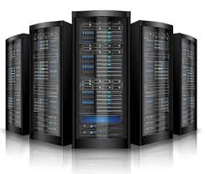
Blockchain basic
Unconfirmed transactions
01 Bitcoin generating transaction
Genesis block
Mining nodes
Unminded block
Blockchain

Slide 14
Blockchain basic
Verifying and adding transactions are really piece of cake by today’s computing standard
Mining nodes can create almost unlimited number of transactions out of thin air without any backing value.

Slide 15
Proof of work - key invention!!!
In order for a block (created by a node) to be accepted by all other nodes. That block miner has to provide a proof-of-work
Find a Nonce - so that, for example:
SHA256(SHA256(block + Nonce)) < T
The less T is, the harder it is to find Nonce

Slide 16
Proof of work
2⁶⁶ Number of grains of sand on the earth.
2⁷⁶ Number of stars in the visible universe.
2⁹⁶ Number of atoms in a cubic meter of water.
2¹⁹⁰ Number of atoms in the Sun
All “people” in the known Universe have machines that are 1000 times more powerful than Google, running non-stop for 37 billions years to have a chance of 1/4 billionth to crack a full SHA256

Slide 17
Proof of work
0
2²⁵⁶
T
SHA256(block + Nonce) < T
The easiest target ( 32 zero bits )
Difficulty level = 1
0x00000000FFFFFFFFFFFFFFFFFFFFFFFFFFFFFFFFFFFFFFFFFFFFFFFFFFFFFFFF

Slide 18
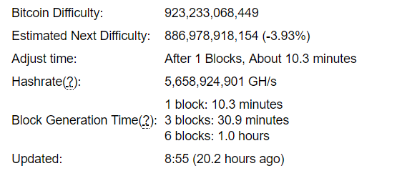
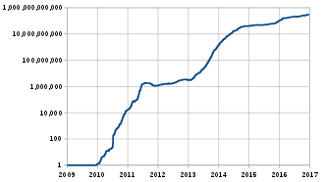
Proof of work

Slide 19
Proof of work
Proof of work creates the backing value for the generated block : hardware + energy cost
Transaction reward creates the incentive for people to build servers to power the system
All nodes mine blocks at the same time, NO way to guarantee which node is the one who is going to finish first. Just like lottery

Slide 20
Regulation
Difficulty level is adjusted after 2016 blocks to maintain ~10-mins block creation rate
Block reward is down by half after 210,000 blocks created. Max 64 times. Now is the second time ( 50 > 25 > 12.5 ). Est end : 2020
Max 21,000,000 Bitcoins will be created
Transaction has fee - after all BTC are mined, miners will live by transaction fee

Slide 21
Double spending protection
Simple rule: Miners only work at the longest chain ( greatest effort to build )

Slide 22
Double spending protection
Binh to Teo: 2 BTC
Teo to Ti : 2 BTC
Teo to Chanh : 2 BTC
Chanh is actually Teo :)
A normal user has zero chance to cheat the system
Cancelled

Slide 23
Double spending protection
Binh to Teo: 2 BTC
Teo to Ti : 2 BTC
Teo to Chanh : 2BTC
What if Teo is also a miner ?
He has to control at least 51% of computing power of the whole system
Mined by Teo
But Ti already sent Teo something tada!!
Cancelled

Slide 24
Merkle tree

Slide 25
Watch faces as NFT
How a watch face verifies its true owner?
Phoenix: WF Id => NFT
Phoenix account AND Etherum address association (?)
Public WF store
Conform to certain NFT standard so that WF can be displayed on-chain

